Slide 1
Content Analysis
Men’s Jacket Design Over Ten Years

Slide 2
Research Problem
Design features that will be seen in men’s jackets next year will be;
Notched lapels because they embrace the casual look
Jetted pockets
Slim fit jackets that are single-breasted
Wider lapel width
Formal and casual versions with lined interiors.

Slide 3
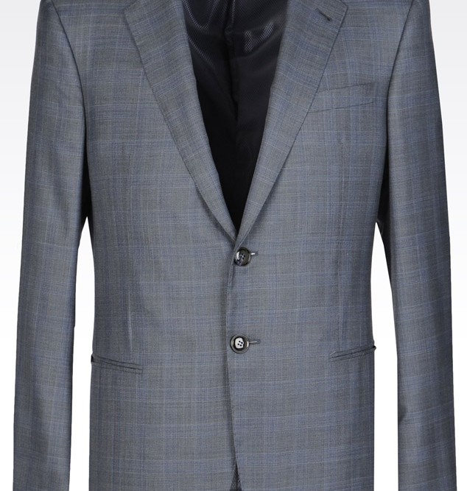
(2019)
(Giorgio Armani)
Full canvassed jacket
Bomb shape, topstitching and sartorial detailing
Inner placket shaped with matching inner piping and striped sleeve lining
Straight rope shoulder with side vents and jetted pockets with a breast pocket
Jetted pockets
Length – 75 cm
Notched lapels
Available Styles:
-single-breasted two-button style
-formal jacket version
Giorgio Armani.(2019).The Story of Timeless Elegance.Retrived from Mr.Ooley’s website :https://mrooleys.com/giorgio-armani/

Slide 4
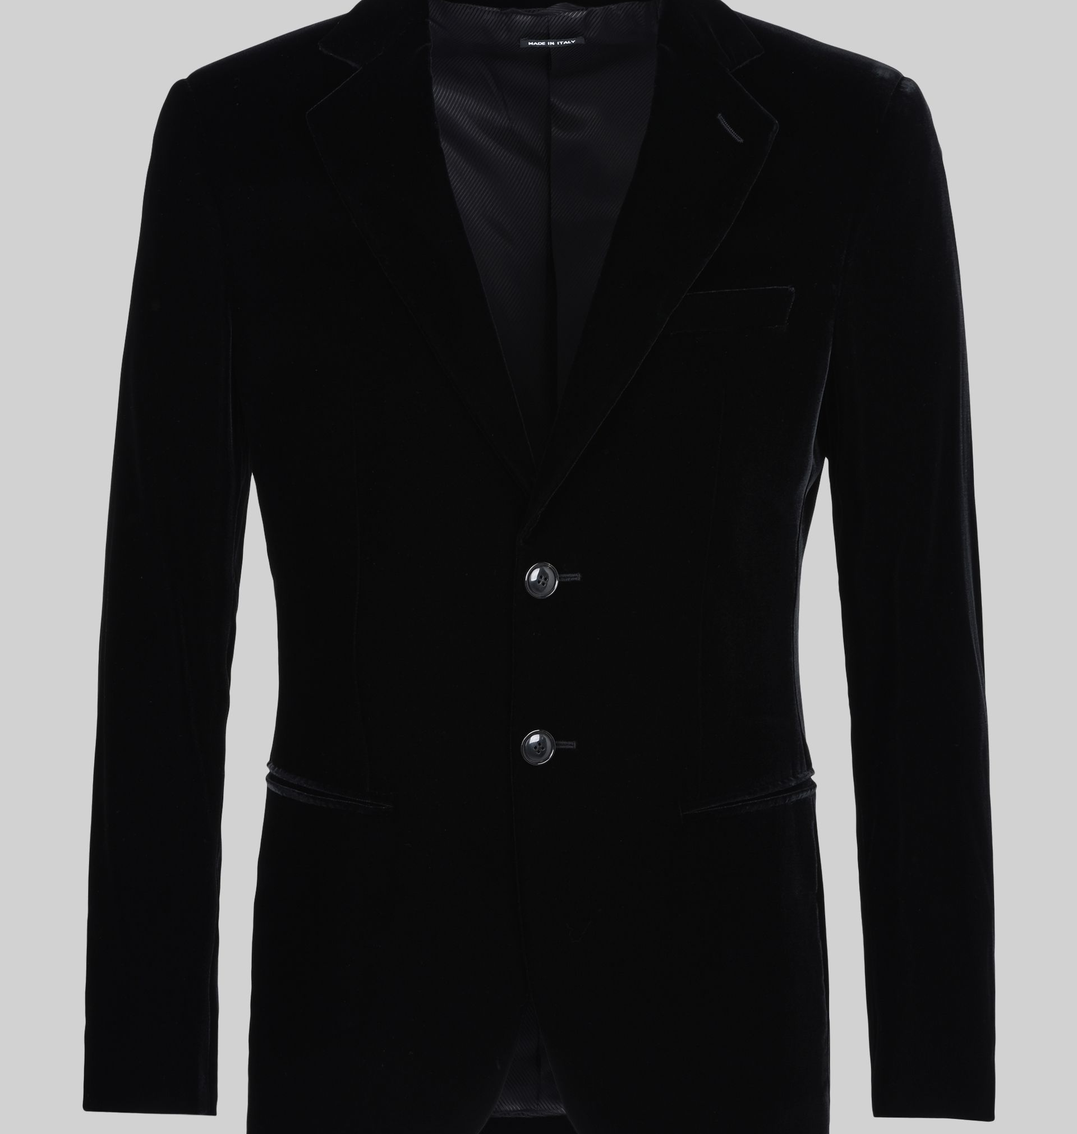
(2018)
(Giorgio Armani)
Single – Breasted Velvet Jacket
Slim – fit
Notched lapels
Welt pockets
A breast pocket
Single- breasted two-buttoned fastening
Lined interior
Length - 74 cm
Giorgio Armani.(2018). Runway Collection.Retrived from Armani website:https://www.armani.com/wx/armanicom/giorgio-armani/single-breasted-velvet-jacket_cod41742000kk.html

Slide 5
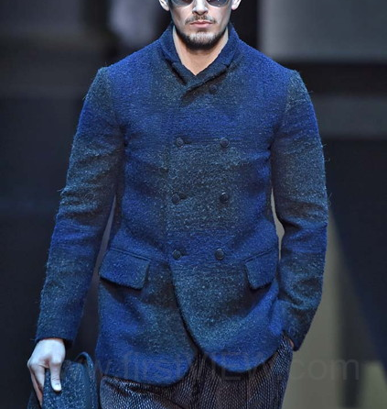
(2017)
(Giorgio Armani)
Peak lapelled
No lining
No breast pocket
Double breasted - 8 buttoned
Flaped pockets
firstView.(2017).Giorgio Armani-Ready-to-wear-Runway Collection-Men,Fall/Winter 2017.Retrived from:http://www.firstview.com/collection_image_closeup.php?of=32&collection=46382&image=7066222#.XKmGVv5RXDc

Slide 6
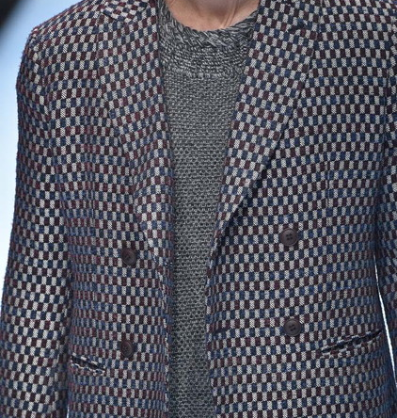
(2016)
(Giorgio Armani)
peak lapelled
Double-breasted – 4 buttoned
Welt pocketed
firstView.(2016).Giorgio Armani-Ready-to-wear-Runway details-Men,Fall/Winter 2016.Retrived from:http://www.firstview.com/collection_image_closeup.php?of=96&collection=43408&image=6169161#.XKmHRf5RXDc

Slide 7
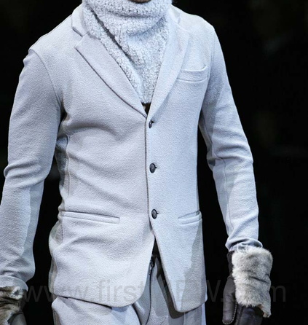
(2015)
(Giorgio Armani)
Notched lapel
Single-breasted
Three-buttoned
Breast pocketed
Jetted pocket
firstView.(2015).Giorgio Armani-Ready-to-wear-Runway details-Men,Fall/Winter 2015.Retrived from:http://www.firstview.com/collection_image_closeup.php?of=2&collection=40848&image=5796866#.XKmHrv5RXDc

Slide 8
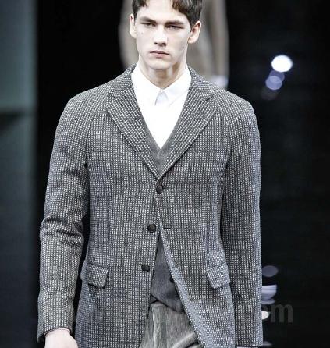
(2014)
(Giorgio Armani)
Notched lapel
No breast pocket
Three-buttoned
Flap pocket
Single – breasted
Peak lapelled
No lining
No breast pocket
Double breasted - 8 buttoned
Flaped pockets
firstView.(2014).Giorgio Armani-Ready-to-wear-Runway Collection-Men,Fall/Winter 2014.Retrived from:http://www.firstview.com/collection_image_closeup.php?of=6&collection=33802&image=4822376#.XKmIef5RXDc

Slide 9
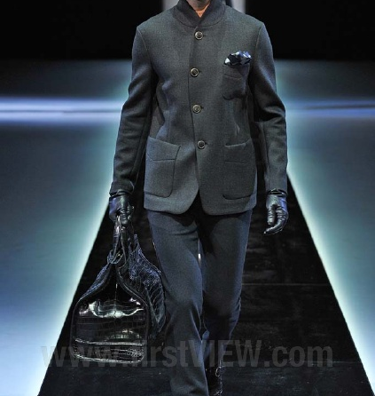
(2013)
(Giorgio Armani)
No lapel
Double – breasted
Four – buttoned
Breast-pocketed
Patched pocket
firstView.(2013).Giorgio Armani-Ready-to-wear-Lookbook-Men,Fall/Winter 2013.Retrived from: http://www.firstview.com/collection_image_closeup.php?of=6&collection=33802&image=4822376#.XKmIef5RXDc

Slide 10
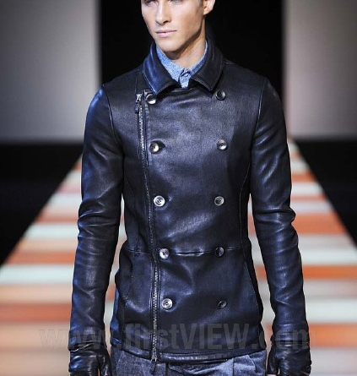
(2012)
(Giorgio Armani)
No lapel
Leathered jacket
No breast pocket
Double breasted with 10 buttons
Side zipped
frstView.(2012).Giorgio Armani-Ready-to-wear-Runway Collection-Men,Fall/Winter 2012.Retrived from:http://www.firstview.com/collection_image_closeup.php?of=7&collection=29745&image=4188418#.XKmI5_5RXDc

Slide 11
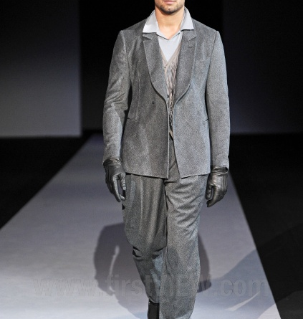
(2011)
(Giorgio Armani)
Notched Lapel
No breast pocket
Single-breasted
One button
Jetted pockets
frstView.(2011).Giorgio Armani-Ready-to-wear-Runway Collection-Men,Fall/Winter 2011.Retrived from: http://www.firstview.com/collection_image_closeup.php?of=9&collection=26310&image=3655895#.XKmJPv5RXDc

Slide 12
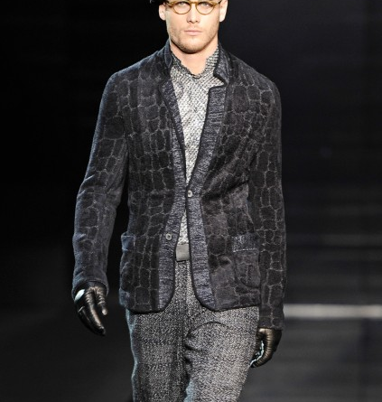
(2010)
(Giorgio Armani)
Notched lapel
Animal print jacket
No breast pocket
Two – buttoned
Single-breasted
Patched pocket
frstView.(2010).Giorgio Armani-Ready-to-wear-Runway Collection-Men,Fall/Winter 2010.Retrived from: http://www.firstview.com/collection_image_closeup.php?of=9&collection=26310&image=3655895#.XKmJPv5RXDc
https://en.wikipedia.org/wiki/Lapel
https://www.realmenrealstyle.com/10-suit-jacket-details/

